Slide 1
Chicago Crime Analysis
by Ebele Shaba (DA)

Slide 2
INTRODUCTION
This dataset was generated from the Onecampus Academy library. It is a crime dataset collected over a period of time from Chicago, USA. It originally contains 2,278,726 entries and 23 columns of information about individuals who committed crime, and the FBI's documentation of such crimes in Chicago.
The goal of the project is to wrangle the data, generate insights to the patterns of crime and create data visualisations to analyse and represent the crime dataset.

Slide 3
Project Process
Data Cleaning
Data Visualisation
Step1
Step2
Step3
Step4
Step5
Data Assessment
Feature Engineering
Insight Generation

Slide 4
Data Assessment
Assessment of tidiness and quality issues in the dataset.
Prescence of missing rows. Missing rows will be dropped to avoid messing up the dataset.
Irrelevant columns. Unnecessary and irrelvant columns which includes;Unnamed: 0,ID,IUCR,Beat,Community Area,FBI Code,X Coordinate,Y Coordinate should be dropped to avoid complicating the dataset.
Changing the date datatype from object to datetime
Spaces between words in column titles. Renaming columns titles to remove space between words

Slide 5
Data Structure
2,070,581 Entries and 21 Features

Slide 6
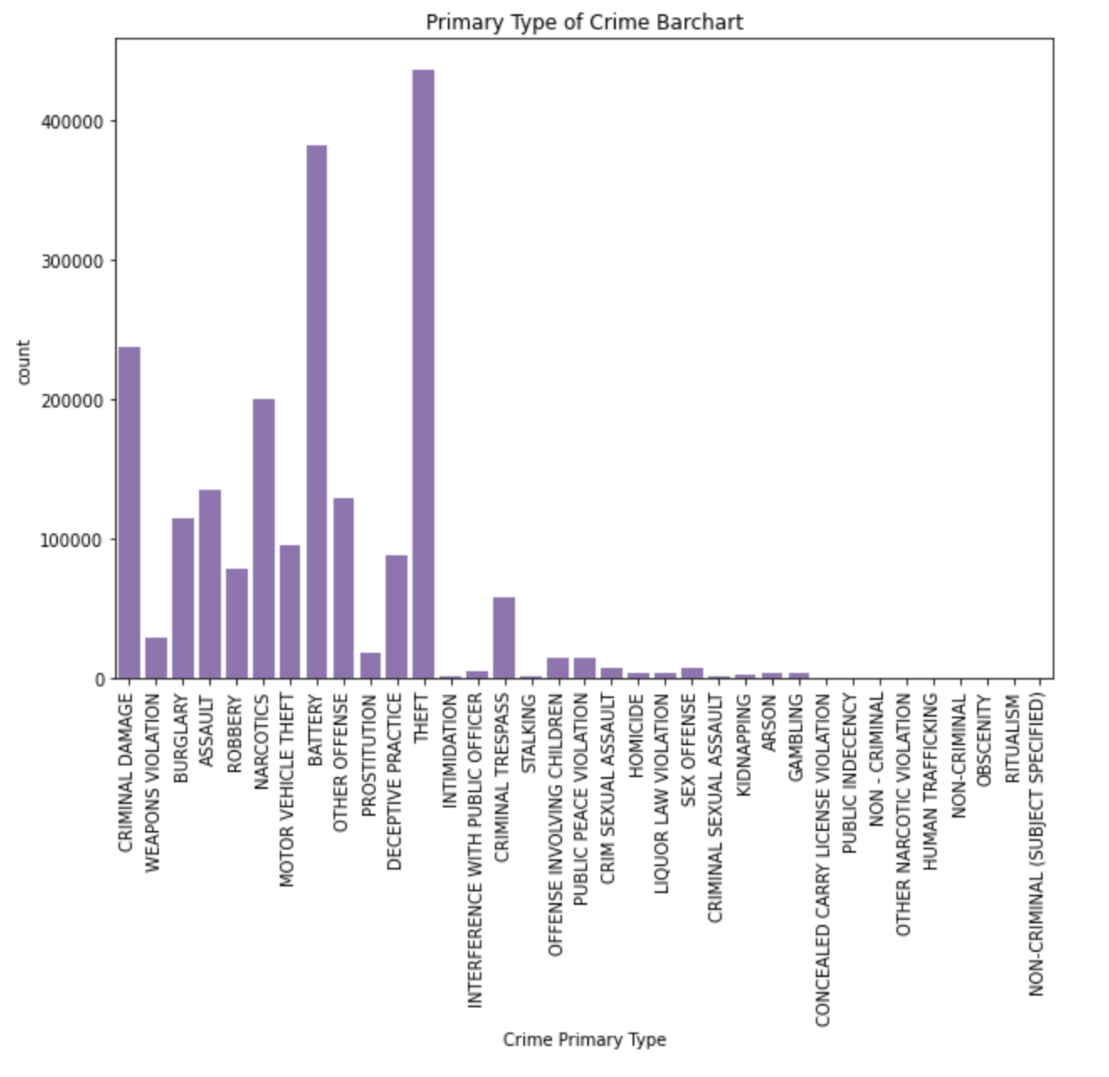
Which crimes are most likey to happen?
Crime count analysis carried out on the types of crime from year 2001 to 2022 shows that theft is the most common type of crime. The top five crimes are Theft, Battery, Criminal violation, Narcotics and Assault. Some of these crimes may be related to low jobs and low paying jobs hence, criminals maybe prone to quick wealth. Perhaps, the community may be sensitized on the importance of dignified wealth to reduce crime.

Slide 7
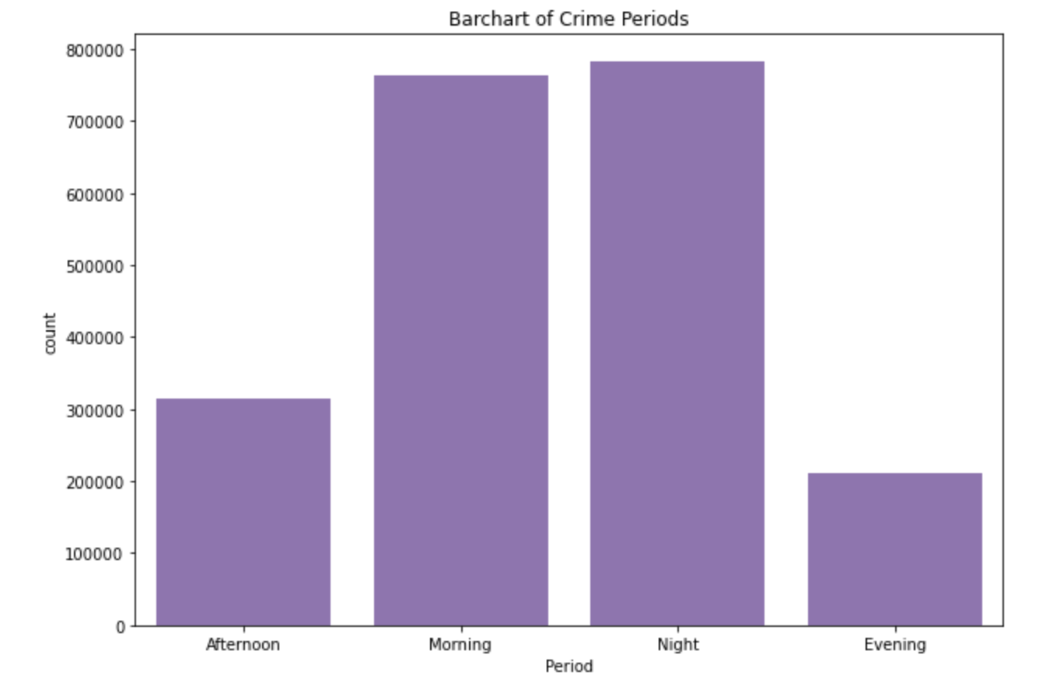
What periods of the day will crimes happen?
From the above the periods that are not safe for people to go out are in the mornings and nights. This may be because there are not street lights or because people cars are not patroling at these hours. Whatever the reason maybe citizens should be advised to stay indoors or move with a group of people at these times

Slide 8
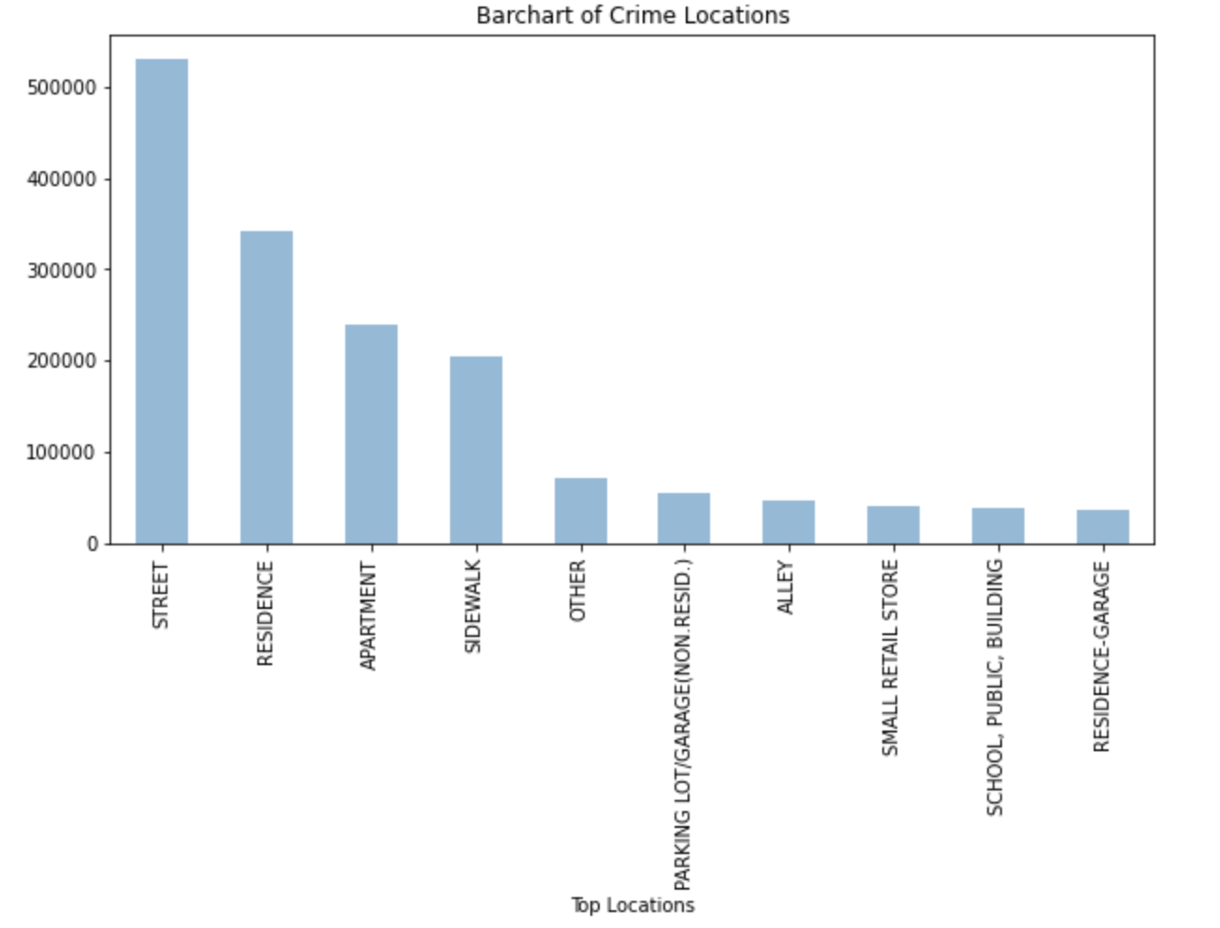
Which locations are the unsafest ones?
The top 10 locations where crime occurs were captured only. Residents should take care when passing through these areas to avoid becoming victims. Also more patrols should be carried out in these locations especially the streets, residencial areas, the sidewalk and so on.

Slide 9
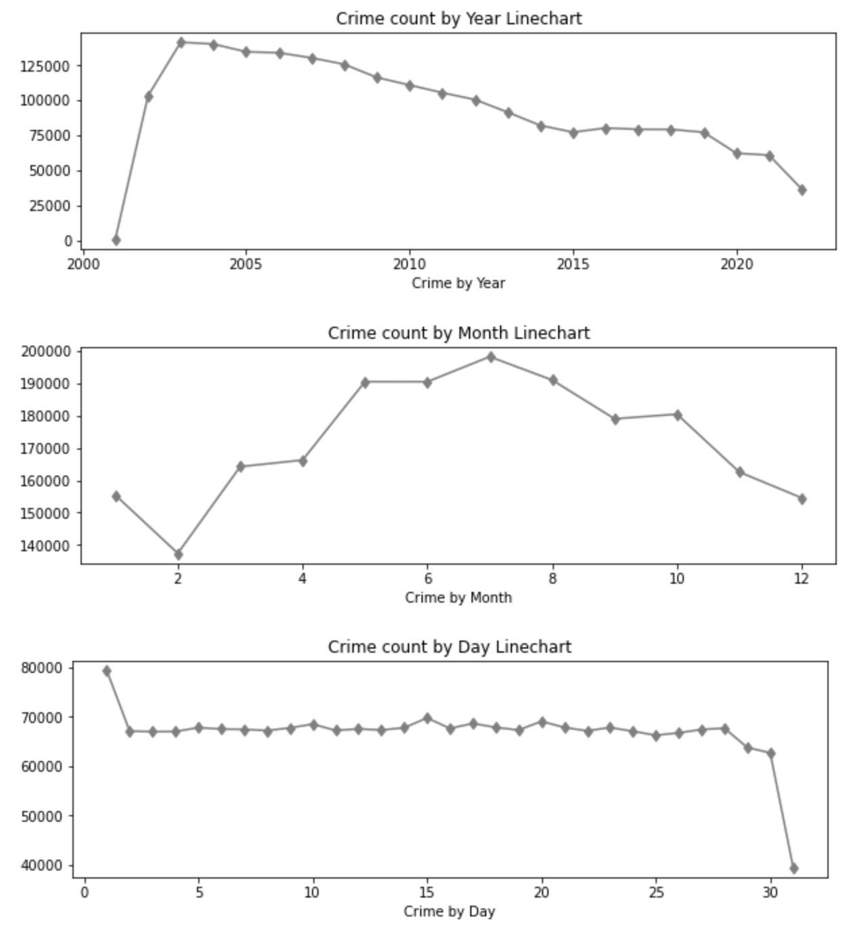
How are the crime trends over days, month and year? which dates have the highest pick?
These linecharts are quite insightful, the first chart shows that crime gradually decreased over the years with the highest crime count in year 2003, the community must be doing something correct to achieve this feet.
From the second chart crime count trends over 21 years shows that crimes majorly occurs during summer time and at the begining of fall. The hot/warm weather may be a contributing factor to increase in crime.
Finally the third linechart shows an almost steady crime rate except on the 1st day of the month were an increase can be seen and the 31st day of the month with a sharp decrease.

Slide 10
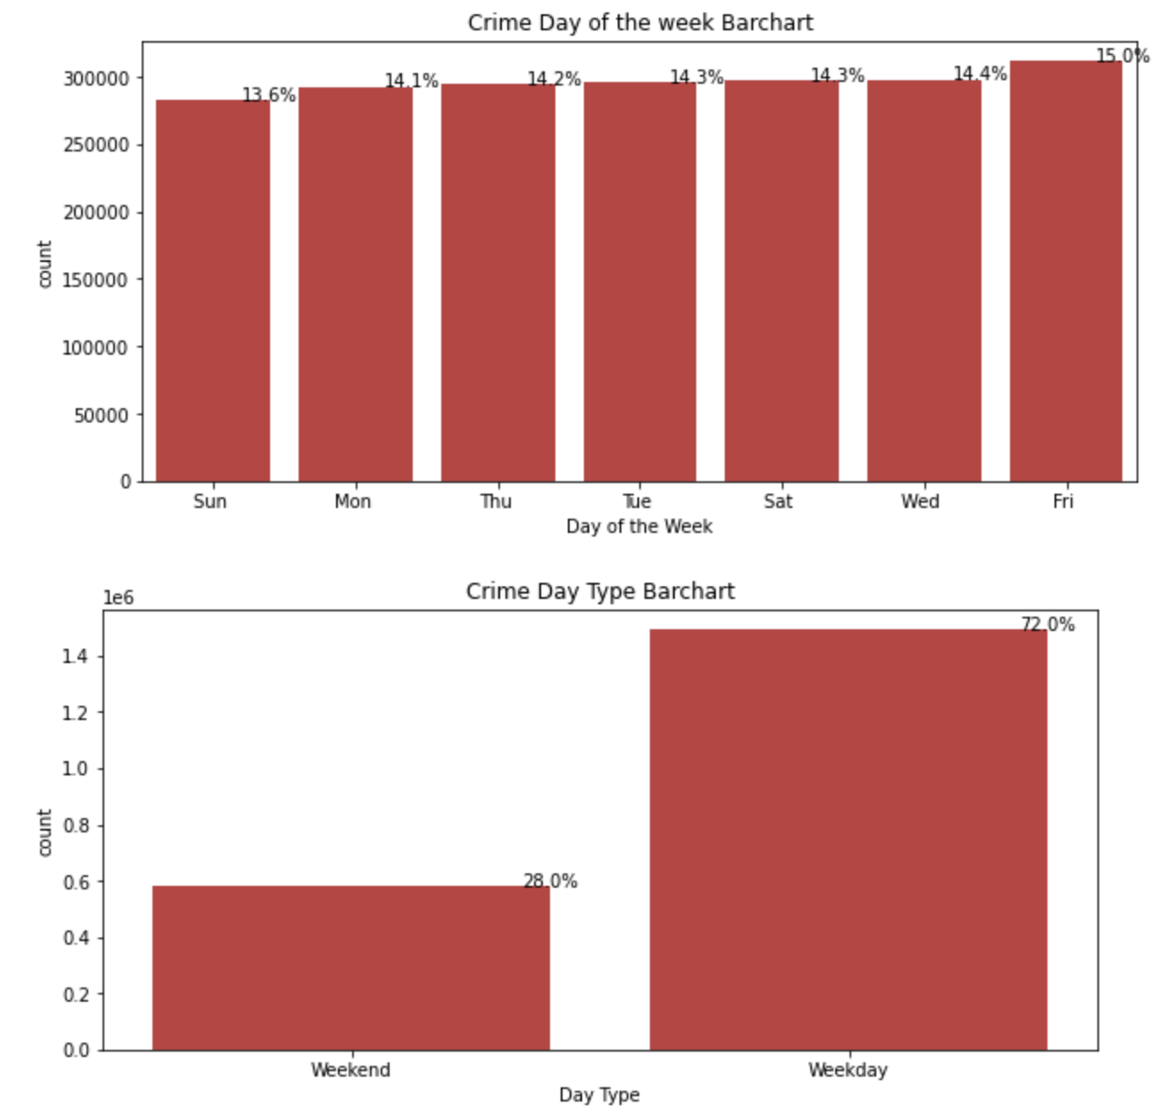
What percentage of crime occurs during the week? When is crime most prevalent?
The differences in the crime counts that happens during the week are not many, the percentage shows a ±2% from sun to sat. However further analysis shows that crimes occurs mostly during the week rather than on the weekends. This maybe because most individuals do not leave the comfort of the homes on the weekends for reasons like work or shopping.

Slide 11
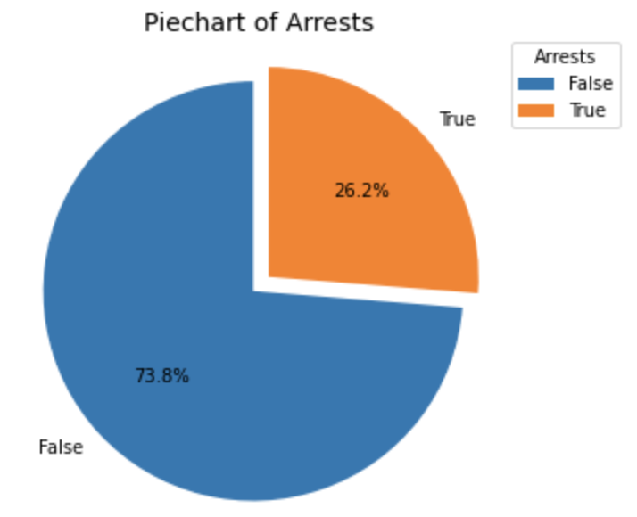
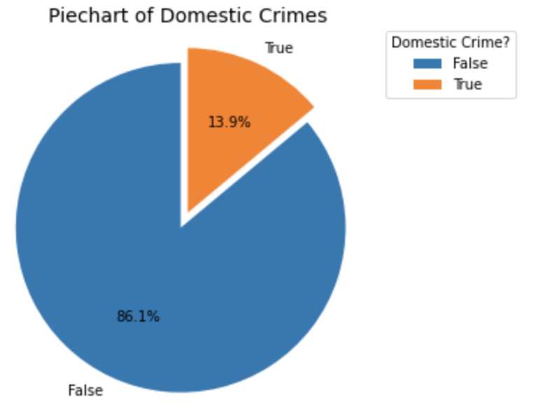
Are arrests mostly successful? What percentage of arrests are successful? What percentage of arrests are not successful?
Unfortunately the piechart shows that less amount of arrest were made successfully, 26.2% of crime to be exact are successfully made. The low rate of crime places a demand on the police department and city officals to answer a lot of questions and pay more mind to the community
Are crimes mostly domestic? What percentage of crimes are domestic? What percentage of crimes are not domestic?
From the second piechart, it can be concluded that domestic crimes(crimes that cause bodily harm for example rape) are low. The criminals may have more regard for human life than property. This a good discovery however the goal is to completely eradicate crime or atleast reduce them to the barest minimum

Slide 12
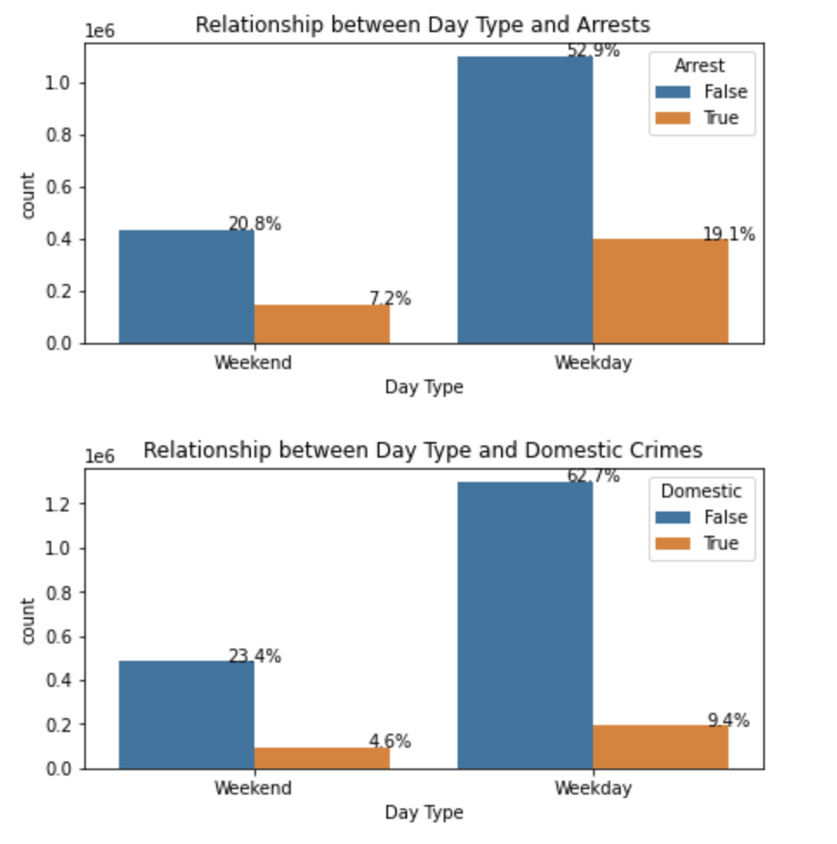
What relationship is there between the day type and arrests, and the day type and domestic crimes? What conclusions can be infered?
The barcharts further establishes the fact that crimes occurs mostly during the week rather than on the weekends in Chicago, and there are less arrests and less domestic crimes accross board.

Slide 13
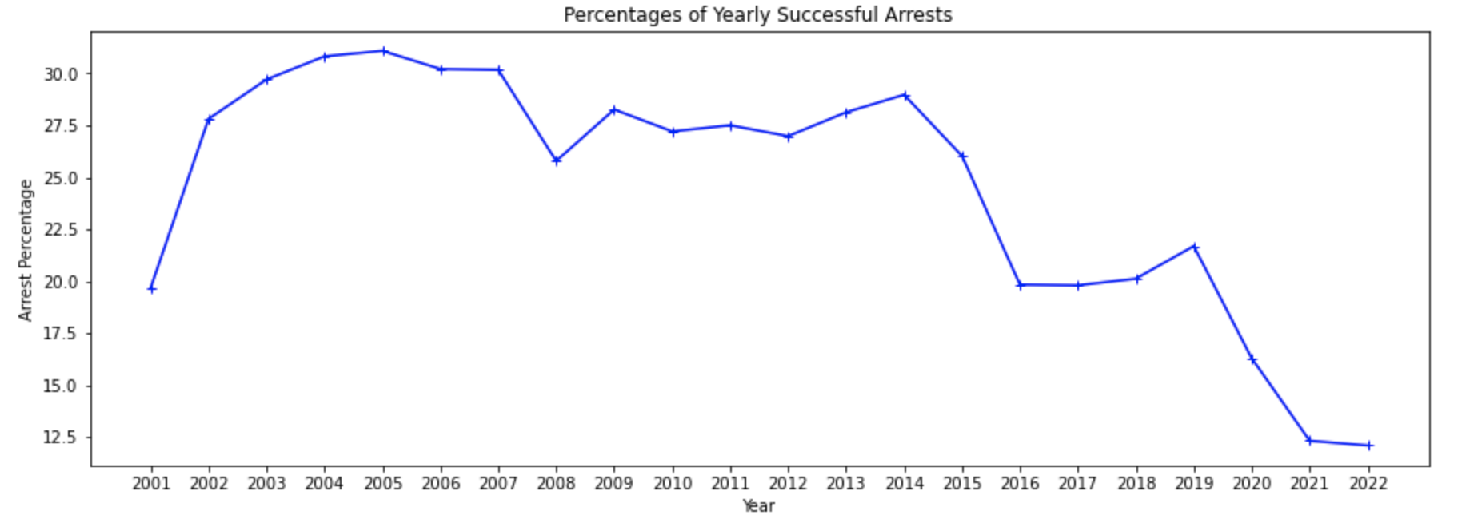
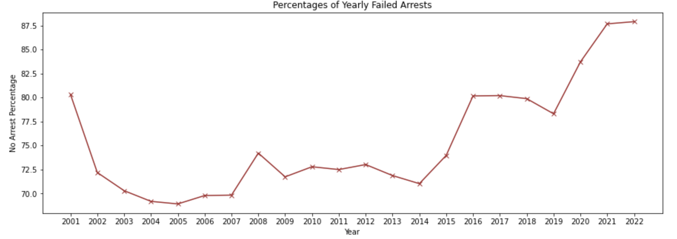
How are the crime trends over days, month and year? which dates have the highest pick?
From the univariate analysis, the crime count trend over 21years were analysed, the chart above however shows the trends in relation to successful arrests. There is a decline with outliying peeks in 2009, 2014, and 2019 in succesful arrests, this may be due to the decline in crimes. The next visual may futher add context to the issue.
How are the crime trends over the years in relation to failed arrests?
In this chart with relation to the 'Percentages of Yearly Successful Arrests' chart, the opposite can be viewed. Failed arrests increases although there is a decline in crime counts over the 21years. Again, the police department and city officals must answer to the reasons why this is so.

Slide 14
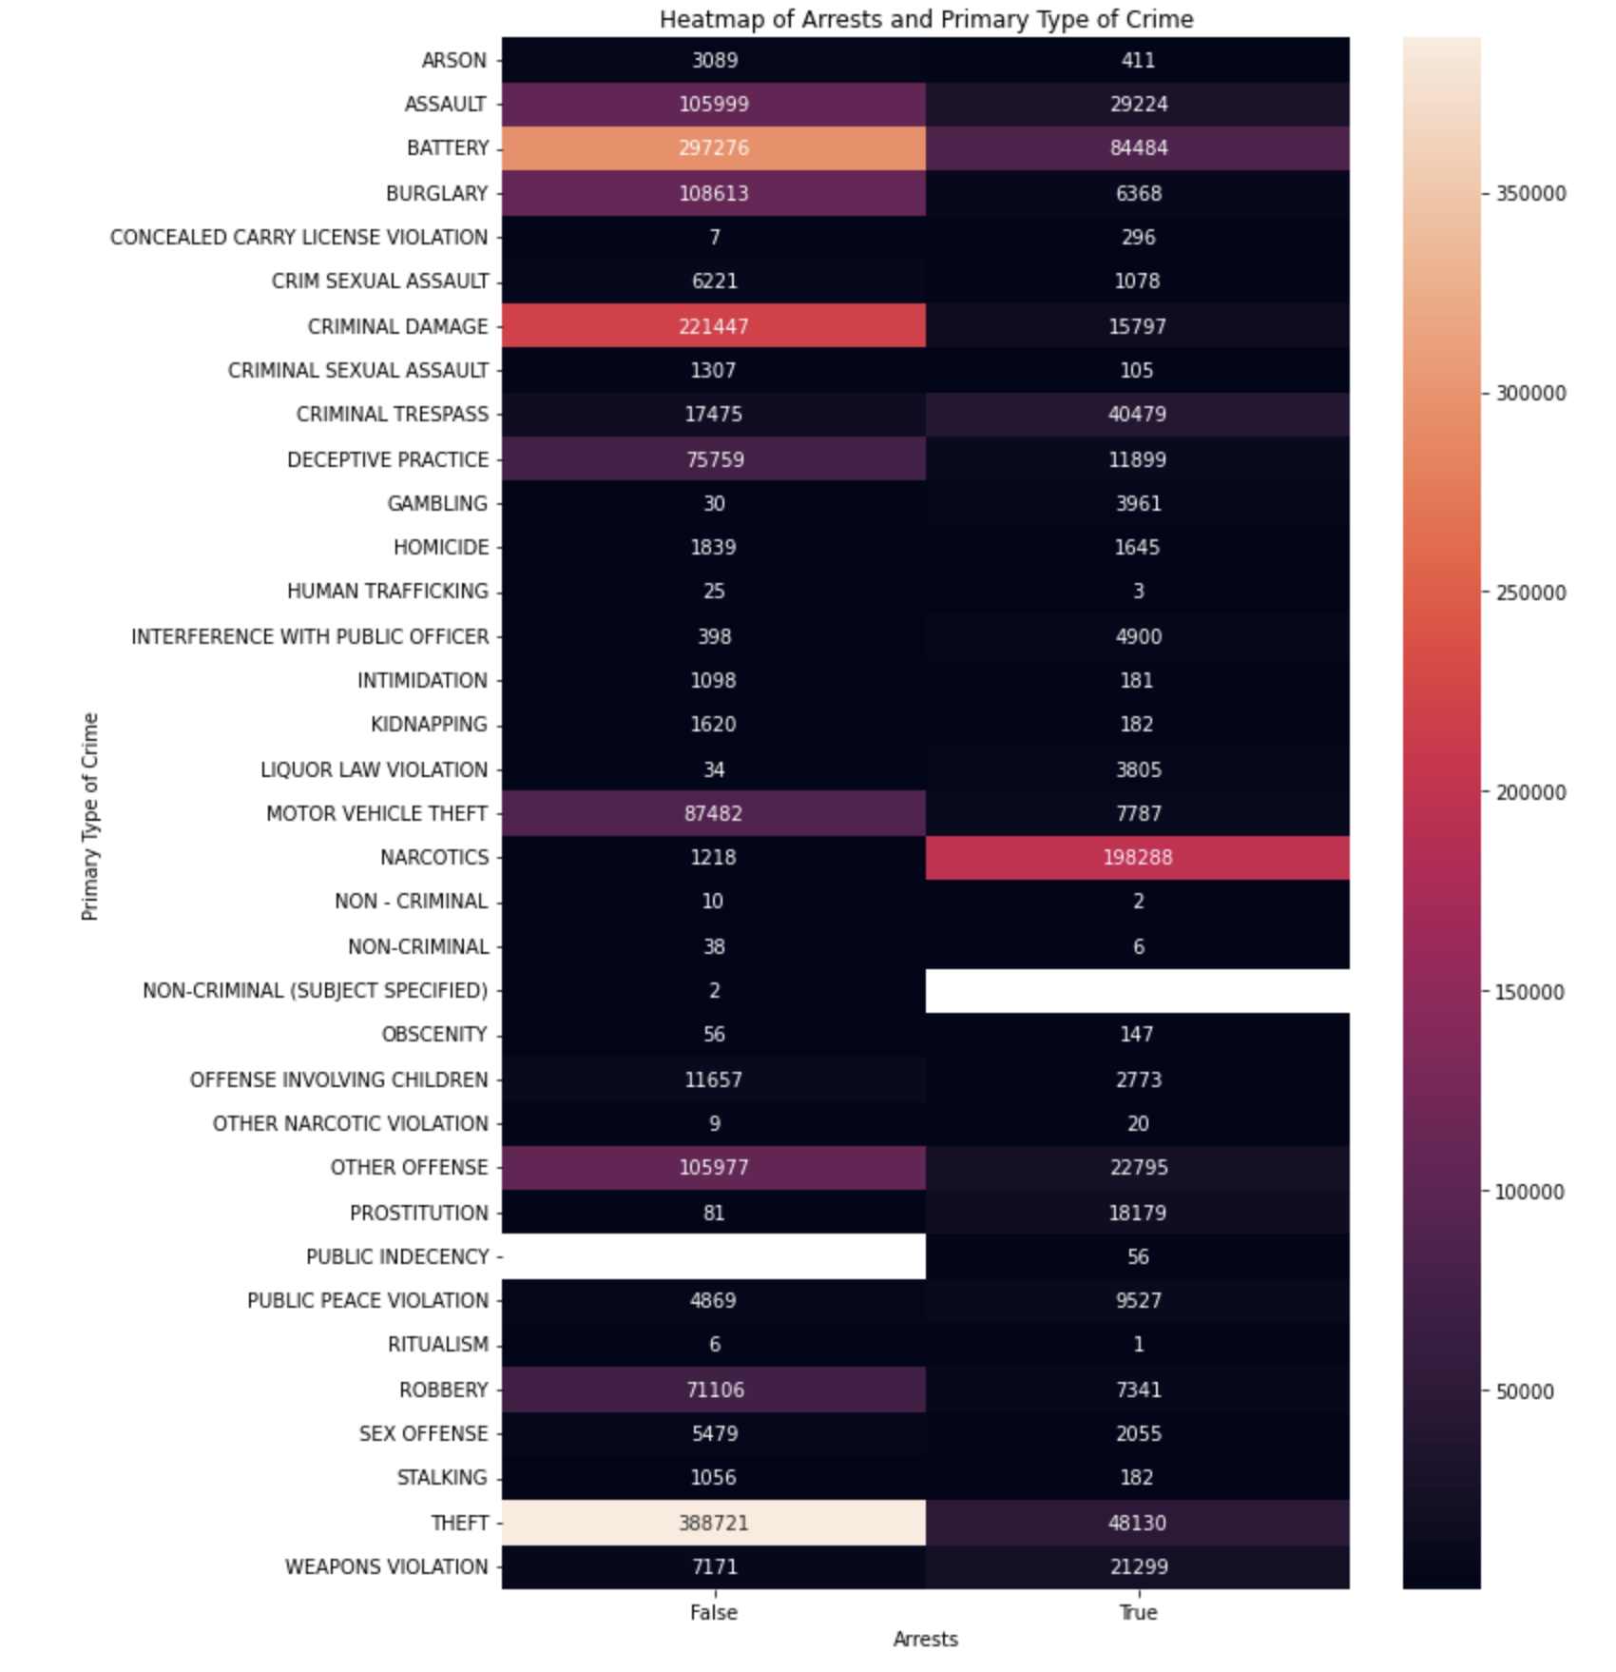
How many arrests occurs or not for the crimes?
The heatmap gives the actual amount of successful and failed arrest of the crime types in Chicago. Theft which the topmost crime has 48,130 arrests and 388,721 failed arrests, this is not encouraging information. However some crimes has more successful arrests such as Narcotics, with 198,288 arrests and 1,218 failed arrests. Perhaps, more efforts are put in by the state officials and police department to catch criminals that commits offense related to Narcotics.

Slide 15
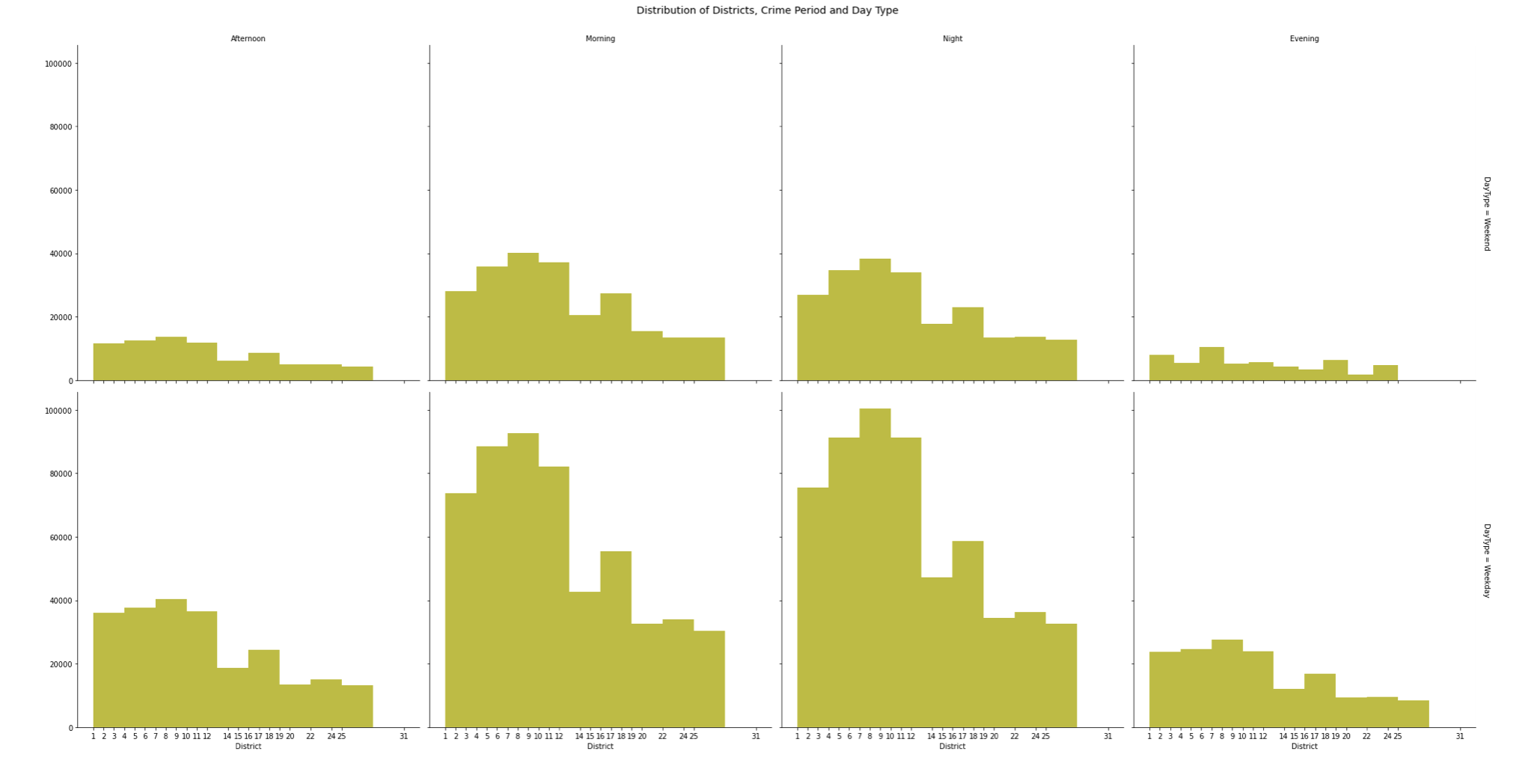
In which locations will crime likely happen at different periods of the day and will it occur during the weekday or weekend?
The Districts in the multivariate charts still shows higher crime rates in the mornings and at night time still emphasing that those periods that are not safe for people to go out. It can also be seen that the crimes are more prevalent in Districts 4-11. The third feature added which is the day type, further detailing a spike of crimes occuring during the weekdays.

Slide 16
CONCLUSION
Chicago is a relatively unsafe place to live, children or the elderly should generally avoid this location. Why? a lot of arrests were not made for crimes.
Fund the Police
Some Districts are more unsafe than other such as Districts 4-11.
Be safety conscious; during the weekdays, at morning or night time, in certain locations such as streets, and finally in summertime.

Slide 17
THANKS

